Slide 1
Research Design and Analysis I
EDUC/PSY 6600
Unit 0

Slide 2
Welcome

Slide 3
Data, Data, Data, Data, Data, ...
Tesla Autopilot

Slide 4
Data, Data, Data, Data, Data, ...

Slide 5
Data, Data, Data, Data, Data, ...
Health Care Policy and Cost

Slide 6
Data are/is Cool
“In God we trust. All others must bring data.”
W. Edwards Deming
“It is a capital mistake to theorize before one has data.”
Sherlock Holmes, “A Study in Scarlett” (Arthur Conan Doyle).
“You can have data without information, but you cannot have information without data.”
Daniel Keys Moran

Slide 7
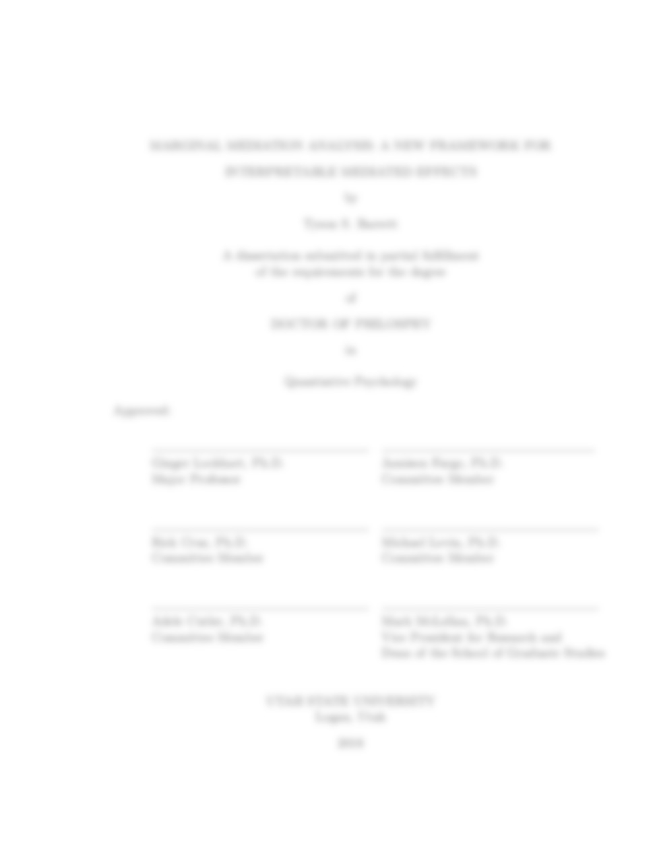

Purpose of this course
Develop quantitative skills
Prepare you for:
Your thesis
Your career
Notes:
Thesis: perform you own analyses and interpret them
Career: communicate with, work with, and understand statisticians and data scientists that you will be working with (they are everywhere…)

Slide 8
What is expected of you
Attend and participate in class
Prepare for class (readings before class)
Professional correspondence with colleagues
Use assignments to learn
Ask questions
Communicate with me

Slide 9
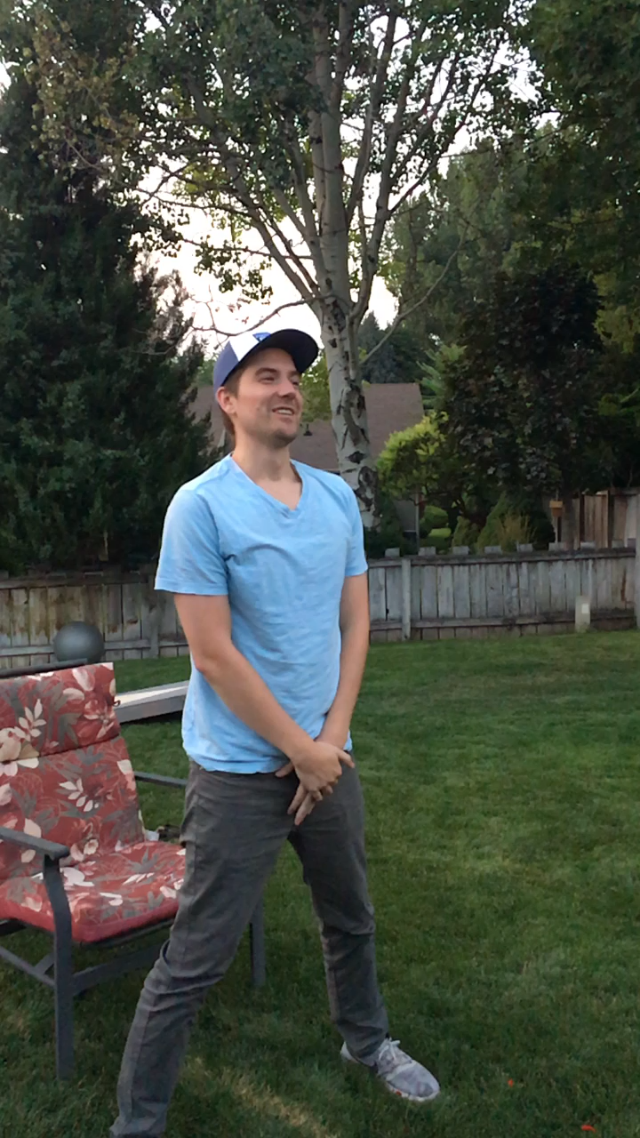
Who am I?
Research Assistant Professor
EDUC 456
tyson.barrett@usu.edu
Office Hours: 2:00 – 3:15 MW
I love Southern Utah (red rocks!)
Huge fan of The Office / Parks and Recreation
Also, I have webbed-toes.
And, I’m clearly fun →

Slide 10
Syllabus
https://tysonbarrett.com/syllabus/educ6600

